Slide 1

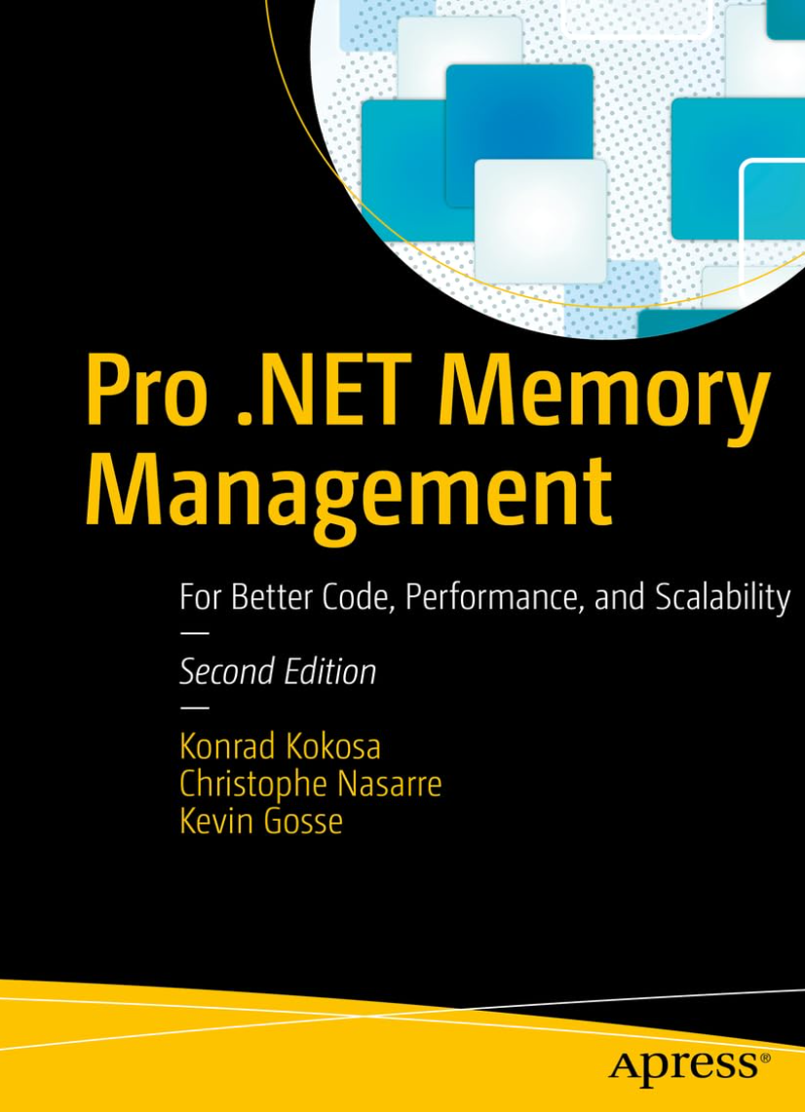
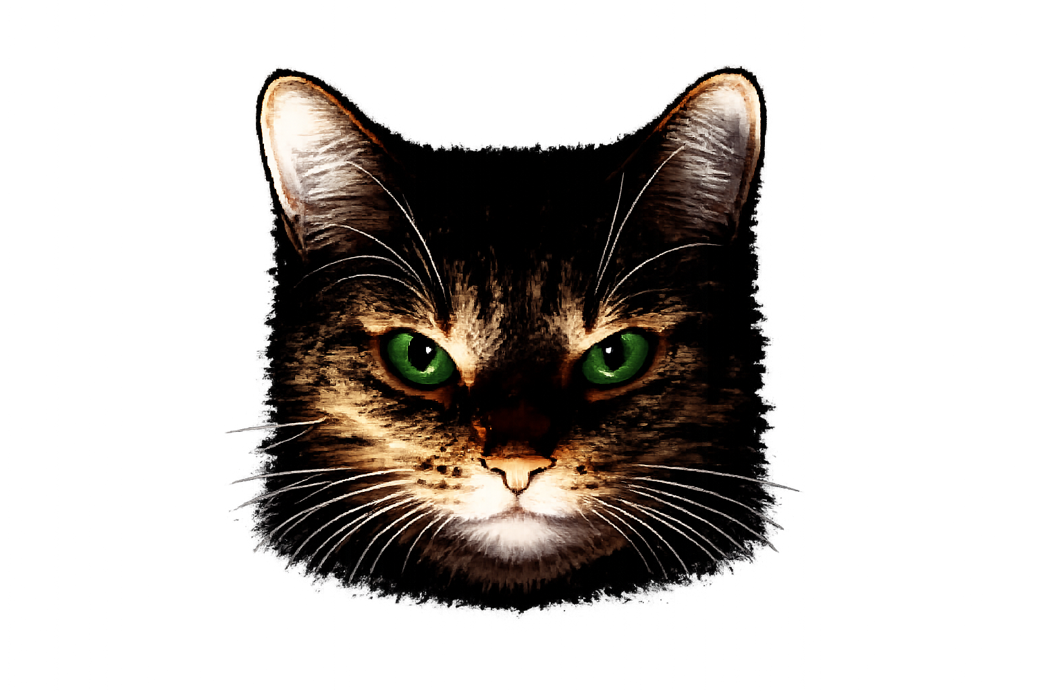

Christophe Nasarre
Senior Developer at Datadog
Twitter @chnasarre
@chrisnas.bsky.social
What did my coding agent
ACTUALLY
do?
From hooks to hidden sessions and plans
Notes:
POLL: raise your hand if you are using agents to generate code
Copilot ?
Cursor ?
Claude ?
Codex ?
ChatGPT :^)
I don’t know for you, but my usage of AI drastically changed in November last year.
Before that, I was using chat bots to brainstorm, trying to get generated code that was full of hallucinated API calls 50% of the time and, if I was lucky, I had to manually copy text in my Visual Studio to realize that it was not compiling.
Things suddenly changed for me with Opus 4.6 and Cursor: the chat was integrated inside my IDE to help me prepare de detailed plan, generate the corresponding code, with no more hallucinations, no more errors (or self fixed!), but more important, no more copy and paste: seamless direct access to my machine (except for permissions)!
Next, step, look at the documentation and free training (I know… I know… but I’m old :^) to understand MCP servers and skills (attend my other talk if you are interested in these subjects).
But how to ensure that these non-deterministic tools are doing what I’m expecting them to do?
Because I need to understand how things work, I started to look inside these agent harnesses by asking them to help me writing tools to dig into their own workflow: for an old developer like me, this was so meta :^)
In this session, I will try to make these magical black boxes less magical and more transparent. In addition, you might get some ideas to improve your own agentic workflows

Slide 2

Copilot, Cursor and Claude
Hooks
Transcript
Session + plans
undocumented
undocumented
Notes:
The major source of understanding came from the documented hooks provided by these harnesses and you will quickly get a fine grained view of what is happening because it is happening « live » while your are using your agents. I will show you other usages of hooks more related to securing your work.
Then, I will spend some time on undocumented stuff:
Transcripts are the agents logs for offline history and analysis
Sessions and plans also provide structure to your work

Slide 3
LLM ~= agent?
User
prompt
Ž
Œ
final response
A model predicts. A harness acts.
Models (LLM)

?
DEMO: Copilot CLI with CopilotSpy
Environment
HOOKS
TRANSCRIPTS
SESSIONS
PLANS
4
Notes:
But first, let start by a demo of a memory leak investigation with Copilot CLI and CopilotSpy/Process Explorer

Slide 4
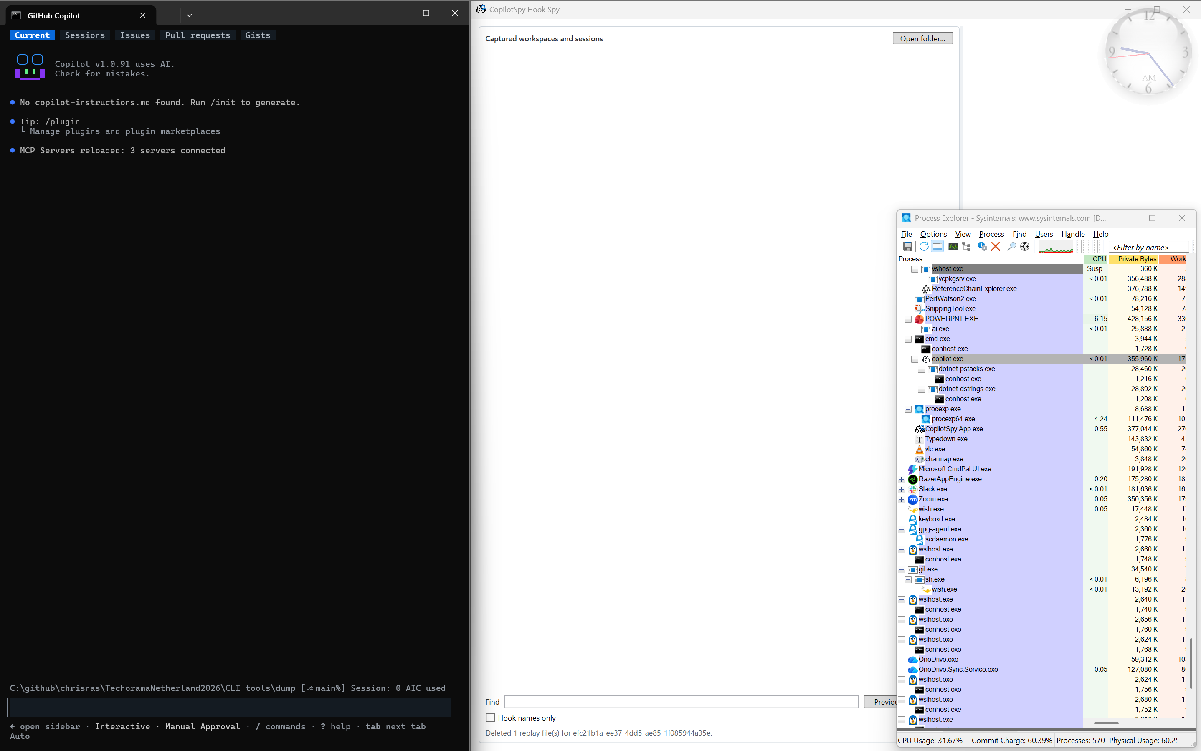
Notes:
DEMO: show worspace, session, turn and MCP/Skills
Start CopilotSpy on the right
Open a command prompt and go to C:\github\chrisnas\TechoramaNetherland2026\CLI tools\dump
start Github Copilot CLI in that prompt → the current folder will be the harness workspace
Start process explorer small on the right and select copilot.exe
/MCP list and show the corresponding processes in process explorer under copilot.exe
/skill list and show my 2 dotnet-*-analysis skills
Type Look for memory leaks based on the files available in current folder to start the first turn of a session
→ look at the processes that will be spawn → you might see ClaudeSpy.Hook.exe because copilot is also generating Claude hooks; don’t ask me why…
Accept all prompts
Look at:
the skill info in purple
Permissions in green
preToolUse for the tools that are executed including Powershell
At the end:
show the summary
Open C:\Users\Christophe Nasarre\AppData\Local\HarnessSpy\Copilot\Payloads to list the payloads by Date

Slide 5
LLM != agent
User
prompt
“
Œ
final response
A model predicts. A harness acts.
Ž
enriched message
Agent Harness
Models (LLM)
Context Assembler
Skills
tool calls

…

P
‘
tool results
Tool Dispatcher
MCP
servers
model response
’

tools call
tools response
Environment
HOOKS
TRANSCRIPTS
SESSIONS
PLANS
4
Notes:
[STORY]
Start from the common misconception that the model is the whole agent. Build the harness around it: the harness assembles context, stores the conversation, applies permissions, invokes tools, manages compaction and delegates to subagents. The model proposes a tool call; the harness performs the real operation.
[BUILD]
Reveal the model first, then the harness capabilities, then the environment. Pulse the path that executes dotnet-dump.
[INTERACTION]
“Who actually starts the process: model or harness?”
[TRANSITION]
“If the harness performs the work, that is the component we must observe.”

Slide 6
Analyze your AI sessions
These are the kind of questions you can answer
MCP / tools
?
Files touched
?
Skill used
?
Plan generated
?
Tokens / dollars consumption
?
HOOKS
TRANSCRIPTS
SESSIONS
PLANS
3
Notes:
[STORY]
Turn the five claims into the investigation checklist. This scoreboard is the narrative spine of the talk and will return after every layer. Stress that a checkmark would be too strong: evidence has provenance and confidence.
[BUILD]
Reveal the five unknown rows. Then show the possible evidence sources and ask for a quick show of hands.
[INTERACTION]
Ask whether they trust final prose, tests/diff, hooks, transcript, or billing data.
[TRANSITION]
“To know where evidence can exist, we first need to separate the model from the agent.”

Slide 7
Three layers of evidence
Increasing reconstruction depth · cost crosses every layer
HOOKS
What happened live?
TRANSCRIPTS
What did the harness retain?
SESSIONS
How do fragments fit?
TOKENS / COST: hard to figure out…
HOOKS
TRANSCRIPTS
SESSIONS
PLANS
5
Notes:
[STORY]
Introduce the four reconstruction layers. Hooks are supported live boundaries. Transcripts are undocumented flight recorders. Session stores assemble durable history from several files and databases.
Plans are not deeper plumbing; they are the highest semantic artifact: intended work.
[BUILD]
Reveal one layer per click. Draw tokens/cost across all four.
[TRANSITION]
“We begin with the only supported live stream: hooks.”

Slide 8
One agent turn through hooks
One prompt can make the harness drive several model and execute may tools
MODEL
model
HARNESS
USER
prompt
preTool
TOOLS
MCP · FILES
stop
postTool
HOOKS
TRANSCRIPTS
SESSIONS
PLANS
6
Notes:
[STORY]
Walk one agent turn without naming every provider hook. The user prompt reaches the harness, the model asks for a tool, the harness handles policy and execution, the result returns to the model, and the loop ends with a response. Hooks are observation windows around these boundaries.
[BUILD]
Advance the token around the loop. Leave each hook marker visible.
[TRANSITION]
“Those markers are executable processes, which means an observer can accidentally change what it observes.”

Slide 9
Hooks have to work on every OS
stdout is used as a control channel (not as the usual log stream)
AGENT HARNESS
Spawns one short-lived process
HOOK PROCESS
stdin: JSON
stdout: no-op
HARNESS SPY
User-only named pipe
HOOKS
TRANSCRIPTS
SESSIONS
PLANS
7

Slide 10
Did I say payload?
Cursor and Claude
Cursor DEMO
  hook_event_name
  conversation_id, generation_id
Claude DEMO
  hook_event_name
  session_id, prompt_id
HOOKS
TRANSCRIPTS
SESSIONS
PLANS
7
Notes:
DEMO:
Show a payload for Cursor from C:\Users\Christophe Nasarre\AppData\Local\HarnessSpy\Cursor\Payloads
Hook_event_name for the event
Conversation_id for the session
Generation_id for the turn
Show the configuration for Claude from C:\Users\Christophe Nasarre\AppData\Local\HarnessSpy\Claude\Payloads
Hook_event_name for the event
session_id for the session
prompt_id for the turn

Slide 11
Did I say payload?
Copilot special case
Copilot in VS Code is… well… not to be used
Copilot DEMO
  No event name!
  session_id
  No turn id!
Is the CopilotSpy tool a magician?
HOOKS
TRANSCRIPTS
SESSIONS
PLANS
7
Notes:
DEMO:
Show the configuration for Copilot from C:\Users\Christophe Nasarre\AppData\Local\HarnessSpy\Copilot\Payloads
No event name
Session_id for the session
No turn id
So… how could the spy even work?

Slide 12
How to register hooks?... in json
Copilot, Claude and Cursor all share a timeout to respond
Copilot DEMO
  .github/hooks/xyz.json
Cursor DEMO
  .cursor/hooks.json, ~/.cursor/hooks.json, C:\Users\<current user>\.cursor\hooks.json
Claude DEMO
  .claude/settings.json
  !! This configuration file is also used by Copilot and Cursor !!
HOOKS
TRANSCRIPTS
SESSIONS
PLANS
7
Notes:
DEMO:
Show the configuration for Copilot
type:command → powershell & syntax
--event : required because… not event name in the payload
-- source : required to make the difference between Copilot in VS Code and Copilot CLI (note that there is no hook in Copilot in Visual Studio)
--runtime : shared model between VS Code and CLI
Show the configuration for Cursor
Very simple
--hook was only added for debugging purpose when some hooks where not received by CursorSpy (but fixed by increased timeout)
Show the configuration for Claude
type:command → powershell & syntax

Slide 13
Are hooks read-only?
Yes in my spy tools but…
stdout is the way
  return code matters (0 = read json from stdout and 2 = block) DEMO
  could be used for validation or modification
Copilot
  “{}” and return 0
Cursor
  “{}” and return 0
Claude
  Empty and return 0
HOOKS
TRANSCRIPTS
SESSIONS
PLANS
7
Notes:
Show hook-response-control-reference.html file

Slide 14
Hooks = control points, not only logs
The same hook can observe or control.
OBSERVE
Audit · OpenTelemetry
Failures · timings
HOOK
CONTROL
Policy · quality gates
Retry · context
BLIND SPOTS
system prompt · full results · raw reasoning · token consumption/billing
transcript_path
HOOKS
TRANSCRIPTS
SESSIONS
PLANS
11
Notes:
[STORY]
Broaden the idea of hooks. The same seam can enforce policy, stop secret-file access, run quality gates, request retries, emit audit events, and feed OpenTelemetry. HarnessSpy chooses the passive branch. Then identify the boundary: hooks do not reveal the fully assembled context, every implicit retrieval, complete tool results, private reasoning, or billing truth.
[BUILD]
Reveal Observe and Control branches, then the blind spots. Finish on transcript_path.
[TRANSITION]
“The hooks themselves point toward a richer but undocumented source.”

Slide 15
Transcript ~= harness log
+ TRANSCRIPT
Transcript content is undocumented
JSONL = line by line JSON
Transcript != chat history
No new session step: complement hooks payload
HOOKS
TRANSCRIPTS
SESSIONS
PLANS
7
Notes:
Transition: the first challenge is to figure out when such a transcript if available

Slide 16
Harnesses do not help…
+ TRANSCRIPT
Transcript paths appear at different moments…or never
CLAUDE
main path at start
CURSOR
path after 2–7 events
CLAUDE
subagent path at stop
COPILOT
path at agentStop
VS CODE LOCAL
No transcript pointer · hooks-only
HOOKS
TRANSCRIPTS
SESSIONS
PLANS
12
Notes:
Here are the times when to expect a transcript path
And these files might not even still be here at that time

Slide 17
Reading a moving target
+ TRANSCRIPT
Copy first. Parse later.
half-written row …
newline → complete row
PATH
accepted hook
TAILER
complete lines
SIDECAR
durable raw row
PARSER
version-pinned
RECONCILER
hook-first
provider file deleted · sidecar survives
HOOKS
TRANSCRIPTS
SESSIONS
PLANS
13
Notes:
Once we know the path, it is time to read its content, row by row.
!! We don’t look at ALL files in a given directory !!
Once a end-of-line is found, copy the resulting line into a sidecar file storageThen, parse and reconcile with the structure built from the hooks

Slide 18
Sidecar == Flight recorder
+ TRANSCRIPT
The harness can clean up; the investigation can continue.
REPLAY
deleted sessions
SEARCH
past sessions
DURABLE
SIDECAR
EVALUATE
regression corpus
INVESTIGATION
security + incidents
PLAINTEXT · SENSITIVE · RETAIN CAREFULLY
HOOKS
TRANSCRIPTS
SESSIONS
PLANS
16
Notes:
These sidecar files could be used to:
Replay deleted sessions
Evaluate how good were our skills/MCP tools
Search (files, tools,…) into previous sessions
Troubleshoot incidents or security validations

Slide 19
Sure !... But for what?
+ TRANSCRIPT
Copilot, Cursor, Claude
Reasoning + final response
MCP server + tool identity
Execution + permission outcomes
Input · output · cache · reasoning
Nano-AIU + premium requests “billing”
System prompts!!!
HOOKS
TRANSCRIPTS
SESSIONS
PLANS
7

Slide 20
Sure !... But for what?
+ TRANSCRIPT
Copilot, Cursor, Claude
Attached skills + paths
Internal tool requests
MCP enrichment
No explicit thinking
No usage accounting
HOOKS
TRANSCRIPTS
SESSIONS
PLANS
7

Slide 21
Sure !... But for what?
+ TRANSCRIPT
Copilot, Cursor, Claude
Readable · opaque · redacted thinking
Exact tool/result IDs
MCP + subagent identity
Skills
Tokens + cost
Durations + line changes
System prompts!!!
HOOKS
TRANSCRIPTS
SESSIONS
PLANS
7

Slide 22
Not easy to match rows and nodes…
+ TRANSCRIPT
Copilot, Cursor, Claude
Hooks with transcriptPath brings session
Timestamps are used to map to a turn
Tools signatures are needed (no tool id)
HOOKS
TRANSCRIPTS
SESSIONS
PLANS
7

Slide 23
From a live spy to an history viewer
+ SESSION
DEMO: SessionViewer
Two applications · two different evidence boundaries
LIVE SPY APPS
Accepted hooks
Named pipe
Hook-first reconciliation
Transcript sidecars
SESSION VIEWER
Harness-owned files
SQLite + JSONL + indexes
Process probes
No hooks · no pipe
HOOKS
TRANSCRIPTS
SESSIONS
PLANS
17
Notes:
[STORY]
Make the architectural boundary explicit. CursorSpy, ClaudeSpy and CopilotSpy start from live hooks and enrich that live tree. SessionViewer is a different tool: no pipe, no hook configuration, no reconciliation with the live observer. It passively reads what providers left on disk.
[BUILD]
Freeze live arrows, fold the session into storage, remove hooks and pipes, reveal SessionViewer.
[DEMO]
Switch applications only after the diagram is complete.
[TRANSITION]
“The first surprise is that a session is rarely stored in one place.”

Slide 24
One session, many artifacts
+ SESSION
A session is reconstructed from fragments.
CURSOR
agent JSONL
state.vscdb
workspace manifest
CLAUDE
sessions index
main + recovery JSONL
subagent files
SESSION
UNKNOWN ROW · RETAINED
COPILOT CLI
events.jsonl · workspace.yaml
HOOKS
TRANSCRIPTS
SESSIONS
PLANS
18
Notes:
[STORY]
Describe the storage archaeology. Cursor combines agent JSONL with internal SQLite and workspace manifests. Claude combines an index, normal and recovery JSONL, plus subagent files. Copilot CLI uses an event stream and workspace metadata. Unknown records are retained as provenance instead of being forced into the common tree.
[BUILD]
Bring each artifact family toward the common session while leaving provenance tags attached.
[TRANSITION]
“Let us find the opening investigation without knowing which fragment contains it.”

Slide 25
Session archaeology
+ SESSION
Find HARNESS-DEMO-42
DEMO 3A
1
Search → session → turn
2
MCP + file evidence
3
Normalized details → raw source → provenance
HOOKS
TRANSCRIPTS
SESSIONS
PLANS
19
Notes:
[STORY]
Search for HARNESS-DEMO-42 and let SessionViewer reconstruct the session. Follow the exact click path shown in the ribbon. The point of the demo is provenance, not browsing: every normalized node can be traced back to JSONL, SQLite, index, recovery file, or workspace metadata.
[DEMO]
1. Search marker.
2. Open session and turn.
3. Expand parallel calls.
4. Find MCP and dump path.
5. Open Raw source and Provenance.
6. Explain Open-state evidence.
[TRANSITION]
“That tidy tree hides several deliberately conservative merge decisions.”

Slide 26
Session archaeology needs a state machine
+ SESSION
Prefer separation over unsupported certainty.
Same GUID
two projects
KEEP SEPARATE
parentId
CHRONOLOGY ≠ PARENT
Newest file
NOT PROOF OF OPEN
EVIDENCE REQUIRED
EVIDENCE REQUIRED
EVIDENCE REQUIRED
HOOKS
TRANSCRIPTS
SESSIONS
PLANS
20
Notes:
[STORY]
Turn reconstruction into three audience decisions. Same GUID in two projects is not enough to merge. parentId often means record chronology rather than semantic parent. Recent file writes do not prove that the session process is still alive. The system prefers separation or unavailable evidence over a convenient guess.
[BUILD]
Resolve one card at a time after the vote and leave the evidence badge visible.
[INTERACTION]
Ask merge, keep separate, or insufficient evidence.
[TRANSITION]
“Causality is not the only reconstruction trap. Accounting has its own.”

Slide 27
The token arithmetic trap
+ SESSION
Snapshot and delta are different accounting behaviors.
INPUT · SNAPSHOTS
100 100 100
OUTPUT · DELTAS
10 15 5
TOTAL = 330 ?
INPUT 100 · OUTPUT 30
max(snapshot) · sum(delta)
HOOKS
TRANSCRIPTS
SESSIONS
PLANS
21
Notes:
[STORY]
Most token bugs are aggregation bugs. Some fields are cumulative snapshots repeated on every response; others are deltas; shutdown records may be final snapshots. Sum only deltas, otherwise use the strongest/latest snapshot. Mention cache tokens, retries and subagents only after the simple example is solved.
[BUILD]
Invite the wrong sum first, then overlap snapshots and stack deltas.
[INTERACTION]
Ask for the total of input 100/100/100 and output 10/15/5.
[TRANSITION]
“Even correct token arithmetic is not automatically a bill.”

Slide 28
From token evidence to billing truth
+ SESSION
Correct tokens are evidence. Charged dollars need authority.
BILLING API / INVOICE
what was charged
OFFICIAL TELEMETRY
request + tool attribution
LOCAL ARTIFACTS
client-reported usage
MCP INTERNAL COST
unknown unless reported
HOOKS
TRANSCRIPTS
SESSIONS
PLANS
22
Notes:
[STORY]
Separate usage evidence from spend authority. Local hooks and transcripts answer “what the client reported.” Official OpenTelemetry adds request spans, tool execution and attribution. Billing APIs or invoices answer “what was charged.” Cursor can join usage by conversationId; Claude reports estimated cost; Copilot can expose provider units. An MCP tool may hide another model call entirely.
[BUILD]
Move the evidence card up the ladder and branch the MCP unknown cost.
[TRANSITION]
“With provenance and accounting attached, a historical session becomes useful for more than browsing old chats.”

Slide 29
The session becomes an engineering artifact
+ SESSION
History becomes reusable engineering evidence.
SEARCH / KNOWLEDGE
reuse solved investigations
COMPARE / EVALUATE
models, prompts, attempts
RESUME / HANDOFF
continue with context
AUDIT / GOVERN
failures, files, retention
HOOKS
TRANSCRIPTS
SESSIONS
PLANS
23
Notes:
[STORY]
Reframe the session as an engineering artifact. It supports search, team learning, attempt comparison, evaluation, incident reconstruction, resume/handoff, and governance. Emphasize that every downstream use retains the evidence limitations of the source session.
[BUILD]
Duplicate the session into four uses while keeping provenance attached.
[TRANSITION]
“Sessions tell us what happened. They still do not tell us what was supposed to happen.”

Slide 30
Execution versus intent
+ PLAN
Execution is evidence of reality. A plan is evidence of intent.
OBSERVED EXECUTION
Read dump
Call MCP tool
Inspect output
Touch files
INTENDED PLAN
Collect evidence
Diagnose root cause
Propose fix
Verify
UNMATCHED
HOOKS
TRANSCRIPTS
SESSIONS
PLANS
24
Notes:
[STORY]
Introduce plans as intent. A plan is a mutable file with its own lifetime, not merely an assistant paragraph. Session activity records actual tools and files; the plan records intended steps. Links between them need evidence just like tool correlations.
[BUILD]
Build execution first, then reveal the plan and only supported links. Leave unmatched items open.
[TRANSITION]
“Before trusting that link, we must decide who actually owns the plan.”

Slide 31
Who owns this plan?
+ PLAN
Ownership is another correlation problem.
A CREATES
B READS
?
TWO CONTENT
MATCHES
?
EDIT WITHOUT
FINAL BODY
?
Owner = A
Orphan
Partial history
HOOKS
TRANSCRIPTS
SESSIONS
PLANS
25
Notes:
[STORY]
Use three ownership puzzles. A session that creates the plan owns it; another session reading it does not. A unique structured-content match can corroborate ownership, but two candidates force an orphan. An edit may prove change without revealing the resulting body, producing a partial revision history.
[BUILD]
Pause before each result. Animate strong, non-owning, ambiguous and partial relationships differently.
[INTERACTION]
Ask owner, orphan, or unknown.
[TRANSITION]
“The UI should show those uncertainties rather than hide them.”

Slide 32
Plans and revisions
+ PLAN
DEMO 3B
Bound, revised and orphaned
1
Bound plan and creating turn
2
Observed revisions + partial marker
3
Orphan Plans: ambiguity stays visible
HOOKS
TRANSCRIPTS
SESSIONS
PLANS
26
Notes:
[STORY]
Continue in SessionViewer. Show a plan directly beneath its session, navigate to the creating/updating turn, inspect the revision list, explain the partial marker, and finish in Orphan Plans. Keep the explanation on ownership and evidence rather than provider-specific settings.
[DEMO]
Follow the four-step ribbon. Use the same sanitized dataset as Demo 3A.
[TRANSITION]
“Once intent and execution are both present, plans can become a governance and quality signal.”

Slide 33
Plans enable drift analysis
+ PLAN
Proposed next view · not current HarnessSpy UI
PLANNED
dump/Investigation.dmp
MCP: duplicated strings
README.md
Run verification
OBSERVED
dump/Investigation.dmp
MCP: duplicated strings
secrets.env
Verification missing
OUT OF PLAN
NOT VERIFIED
HOOKS
TRANSCRIPTS
SESSIONS
PLANS
27
Notes:
[STORY]
Describe the next semantic use without claiming it is already implemented. Compare planned and observed files/tools. An unexpected file, missing verification step, or abandoned plan can drive review, budget, handoff, and architecture-history workflows.
[BUILD]
Connect matches, then reveal one out-of-plan action and one unfinished item. Keep “Concept, not current UI” visible.
[TRANSITION]
“Before claiming novelty, place this investigation beside what the 2026 ecosystem already provides.”

Slide 34
What public tooling already solves
+ PLAN
Hook tracing is useful—but no longer unique.
LIVE TELEMETRY
LangSmith Cursor
Claude / Copilot OTel
OTel hook projects
LOCAL HISTORY
Multi-agent viewers
JSONL + SQLite
Search + analytics
OFFICIAL PROTOCOL
Codex App Server
Thread → Turn → Item
DISTINCTIVE: evidence discipline across all layers
HOOKS
TRANSCRIPTS
SESSIONS
PLANS
28
Notes:
[STORY]
Be explicit that hook tracing alone is not unique. LangSmith traces Cursor, official Claude and Copilot telemetry is increasingly rich, OTel hook projects exist, and history viewers parse many local stores. The distinctive angle here is evidence discipline across live boundaries, undocumented records, historical reconstruction, intent, and billing. Codex App Server shows the ideal explicit Thread/Turn/Item contract.
[BUILD]
Reveal ecosystem groups, shift the center from hook tracing to evidence discipline, then build Thread → Turn → Item.
[TRANSITION]
“The distinctive result is not another hook catalog; it is the evidence discipline across all four layers.”

Slide 35
Five claims, now with evidence
EVIDENCE MAP
Replace confidence with qualified evidence.
MCP / tools
Observed + corroborated
Files
Explicit accesses only
Skill
Invoked stage proven
Plan
Bound + partial history
Tokens / dollars
Usage / billing separated
HOOKS
TRANSCRIPTS
SESSIONS
PLANS
29
Notes:
[STORY]
Return to the exact five claims from the opening. Replace each question mark with a qualified evidence statement, not a success check. MCP and tools are observed/corroborated. Files mean explicit accesses only. Skill has a specific lifecycle stage. Plan history can be partial. Tokens are aggregated evidence; dollars may require billing data.
[BUILD]
Flip one row at a time and connect it to its supporting layer. Pause on the Files and Dollars caveats.
[TRANSITION]
“The whole investigation reduces to five rules.”

Slide 36
Five laws for agent forensics
A practical discipline for investigating AI coding agents.
1
Observe the harness, not only the model.
2
Richer evidence is not automatically authoritative.
3
Preserve native identity and provenance.
4
An orphan beats a confident lie.
5
Billing is a separate truth domain.
Q&A · Which layer is missing from your harness?
HOOKS
TRANSCRIPTS
SESSIONS
PLANS
30
Notes:
[STORY]
Close by compressing the journey into five laws. Observe the harness, not only the model. More data is not automatically stronger data. Preserve native identity and provenance. Prefer an orphan to a false causal story. Treat billing as a separate truth domain.
[BUILD]
Reveal one law at a time while reducing the diagram to four layers. Leave the final question on screen for Q&A.
[Q&A]
Open with: “Which layer is missing from the harness you use today?”

Slide 37
Resources
  Reference documentation
  https://cursor.com/docs/hooks
  https://code.claude.com/docs/en/hooks
  https://docs.github.com/copilot/reference/hooks-reference
  My blog series about agentic AI for more details
  https://chrisnas.github.io
  This content
  https://github.com/chrisnas/TechoramaNetherland2026

